Slide 1
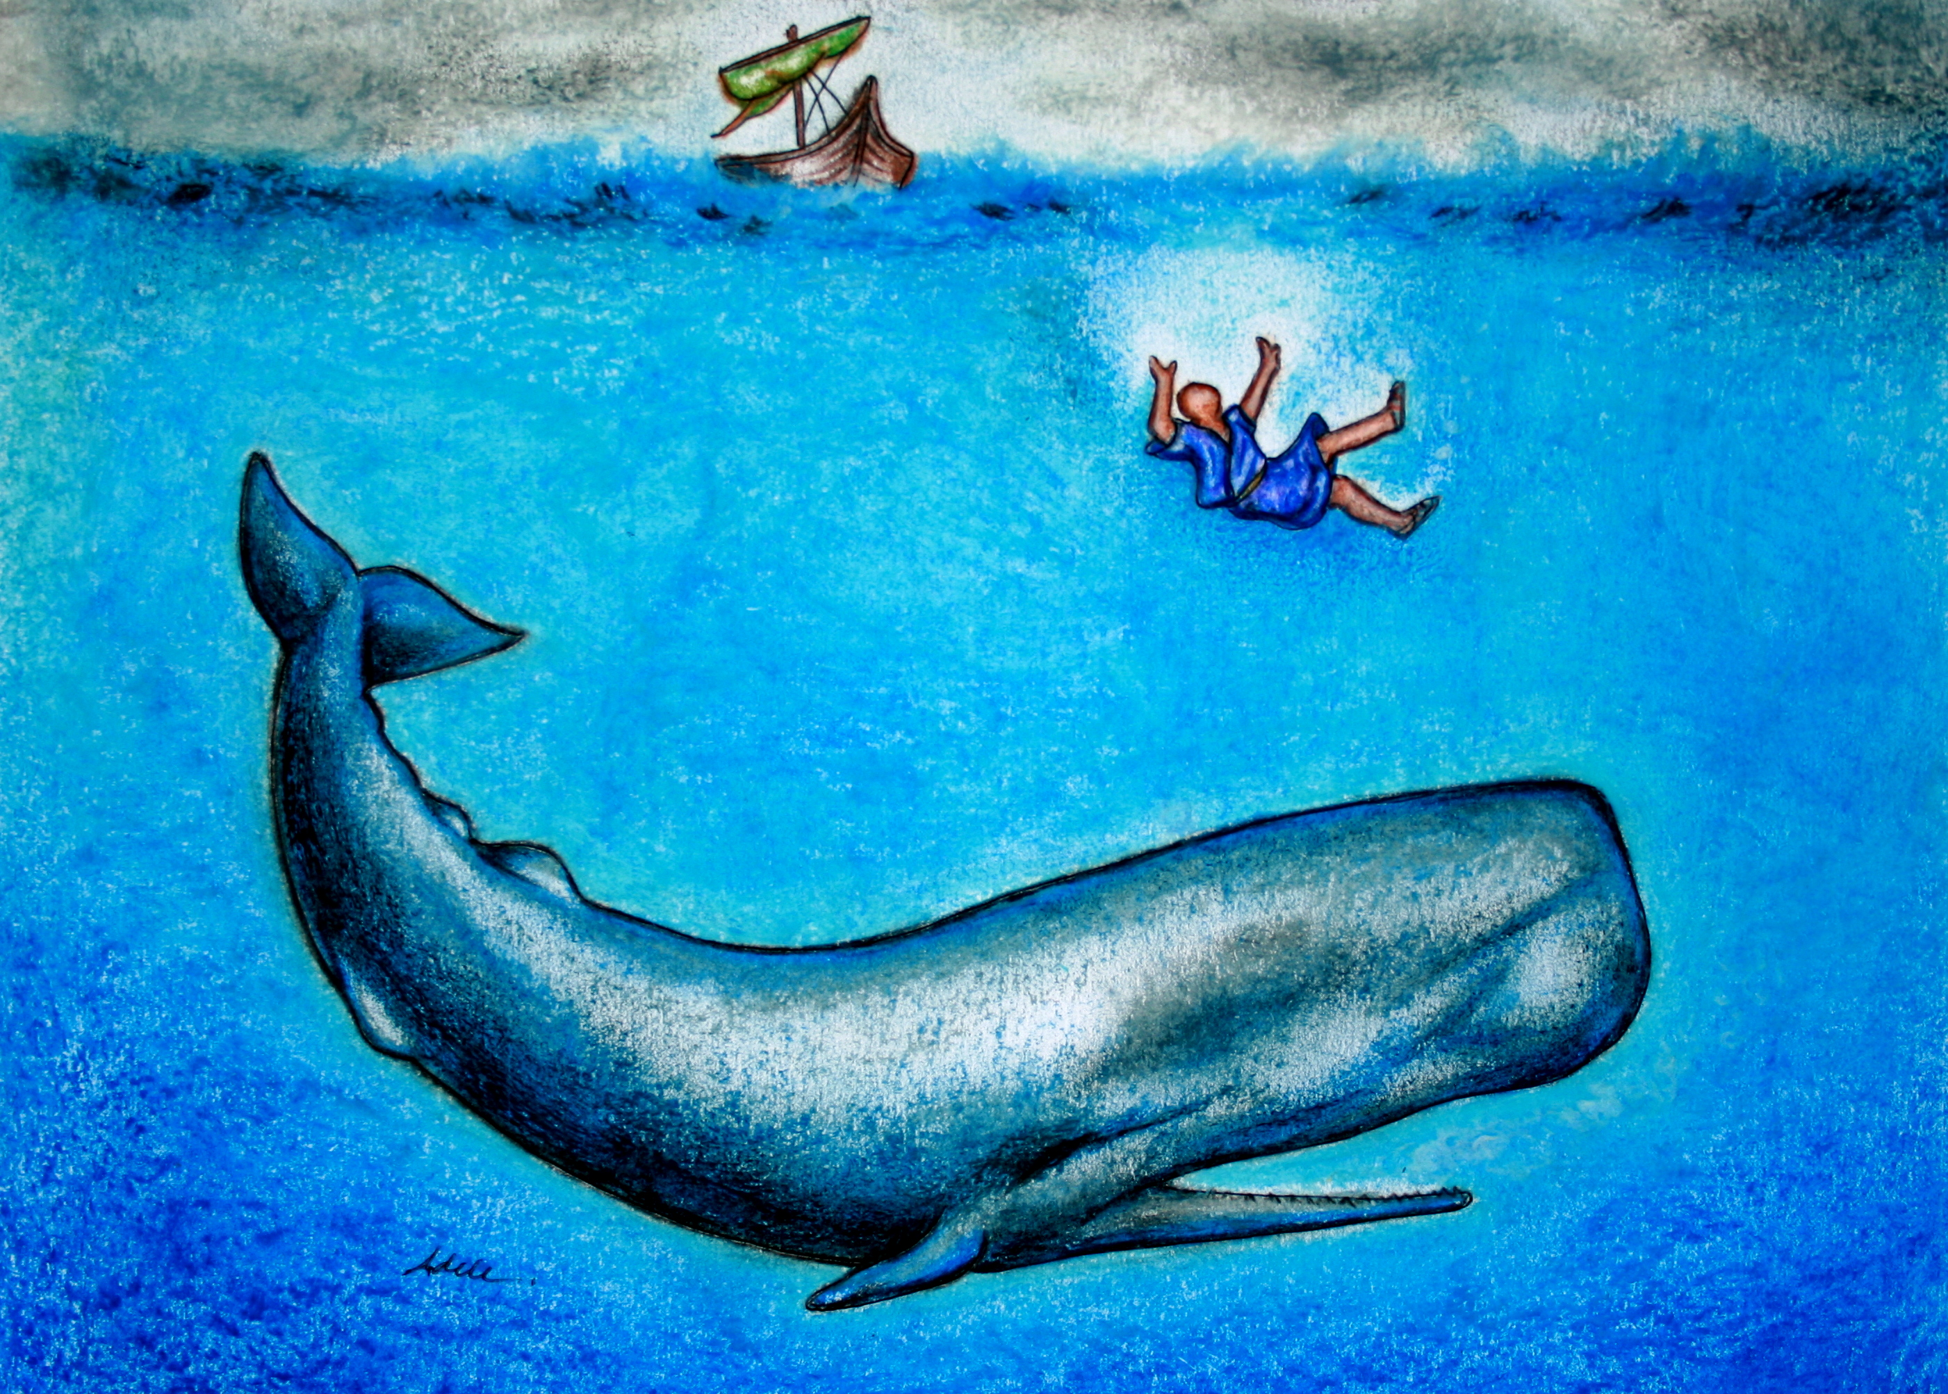
Go Go
Jonah
Chris Jaensch

Slide 2
Go, Go, Jonah,
as fast as you can.
God’s got a job for you.
You’re part of His plan.
Go, Go Jonah,
go to Nineveh town
to turn those crazy, crazy
people around.
Let’s Go! Let’s Go!

Slide 3
But Jonah didn’t wanna go.
No no no.
He didn’t wanna ,
didn’t wanna go go go.
He headed on a ship
the other way, way, way.
‘See ya later, God,
some other day, day, day.’
Oh No! Oh No! Oh No! Oh No!

Slide 4
Go, Go, Jonah,
as fast as you can.
God’s got a job for you,
you’re part of His plan.
Go, Go Jonah
go to Nineveh town
to turn those crazy, crazy
people around.
Let’s Go! Let’s Go!

Slide 5
The ship hit a storm, the waves went crash, crash, crash;
heavy rain and lightning,
flash, flash, flash.
The crew was scared.
Who could they
blame, blame, blame?
‘Jonah was the one’, they said,
‘Shame, shame, shame!’
Oh No! Oh No! Oh No! Oh No!

Slide 6
They threw him in the water
in the gale, gale, gale.
Next thing he’s in the tummy
of a whale, whale, whale.
For three days he’s stuck and thinking, ‘What, what, what?
I think I’ll give God another
shot, shot, shot.’
Let’s Go! Let’s Go! Let’s Go! Let’s Go!

Slide 7
Go, Go, Jonah,
as fast as you can.
God’s got a job for you.
You’re part of His plan.
Go, Go Jonah,
Go to Nineveh town
to turn those crazy, crazy
people around.
Let’s Go! Let’s Go!

Slide 8
So Jonah did the trip
Like he was told, told, told.
He went to Nineveh
and he was bold, bold, bold.
He warned all the people
in that town, town, town.
They listened and their lives were turned around, ‘round, ‘round.
Hooray! Hooray!
Hooray! Hooray!

Slide 9
Go, Go, Jonah,
as fast as you can.
God’s got a job for you.
You’re part of His plan.
Go, Go Jonah
Go to Nineveh town
to turn those crazy, crazy,
turn those crazy, crazy,
turn those crazy, crazy
people around. Let’s Go!

